Slide 1
Creating a Procedural City
CSCI 580
Joel Jurik
Chris Mangus
James Reinebold
Samuel Woo

Slide 2
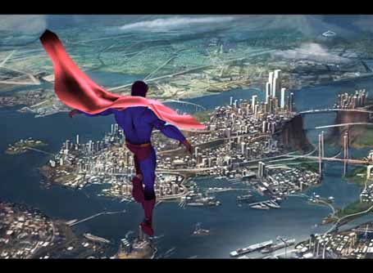
Procedural Modeling
Motivation: developing large sets of visually pleasing 3D models is time consuming and expensive.
  The urban models in the movie “Superman Returns” took 15 man years to complete!
Procedural modeling uses automated techniques to generate 3D models (similar to procedural texturing)

Slide 3
Continuous Model Synthesis
Algorithm which takes a seed model and produces a similar model to it by using a set of decision functions.
Exploits the connectivity information of the original model to create a new model.

Slide 4

The Basic Algorithm – 2D
Grid = []
States = []
Model = []
For each edge in shape:
Add a set of parallel lines to the grid
For each intersection point v in grid:
states += all valid states of v
while states is not empty:
S = random state in states
Add S to Model
Remove all states conflicting with S from states
Remove S from states

Slide 5
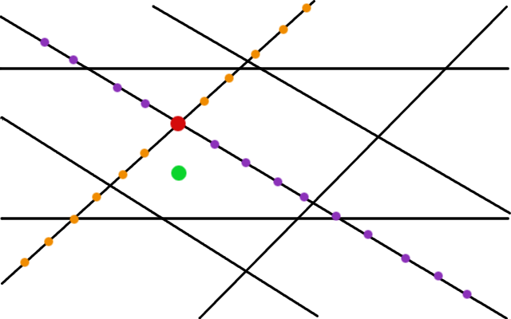
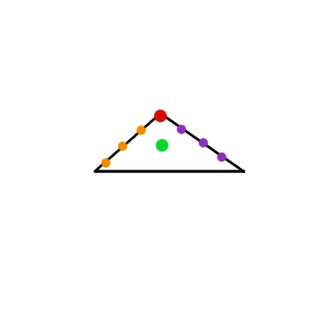
What are valid states?

Slide 6
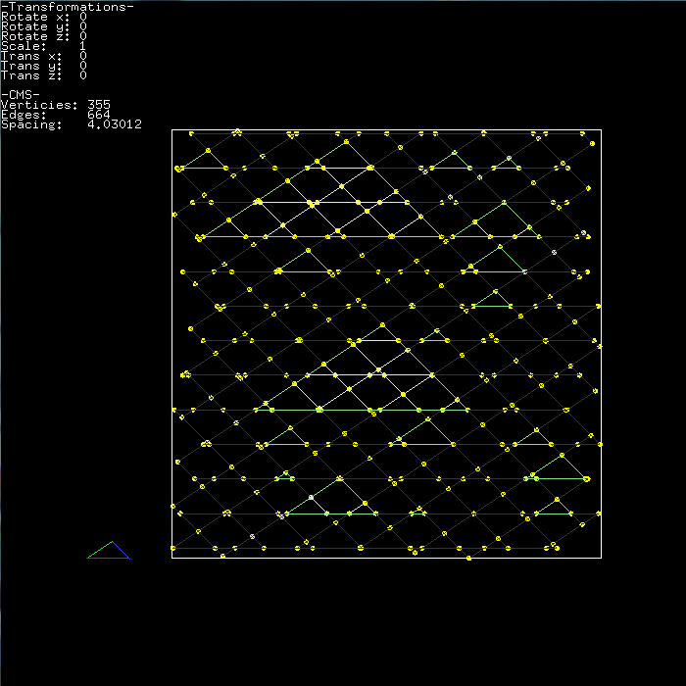
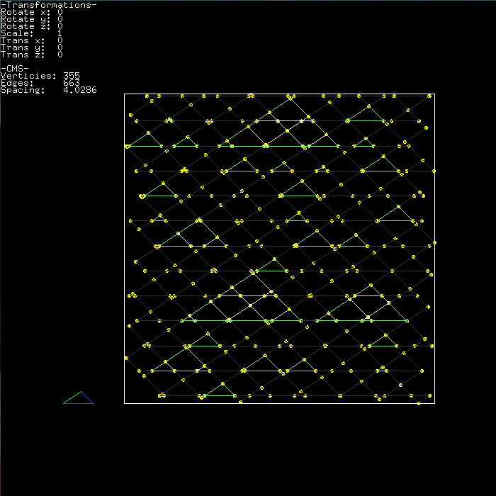
2D Results

Slide 7

The Basic Algorithm – 3D
Grid = []
States = []
Model = []
For each face in the input:
Add a set of planes parallel to face to grid
For each intersection point v in grid:
states += all valid states of v
while states is not empty:
S = random state in states
Add S to Model
Remove all states conflicting with S from states
Remove S from states

Slide 8
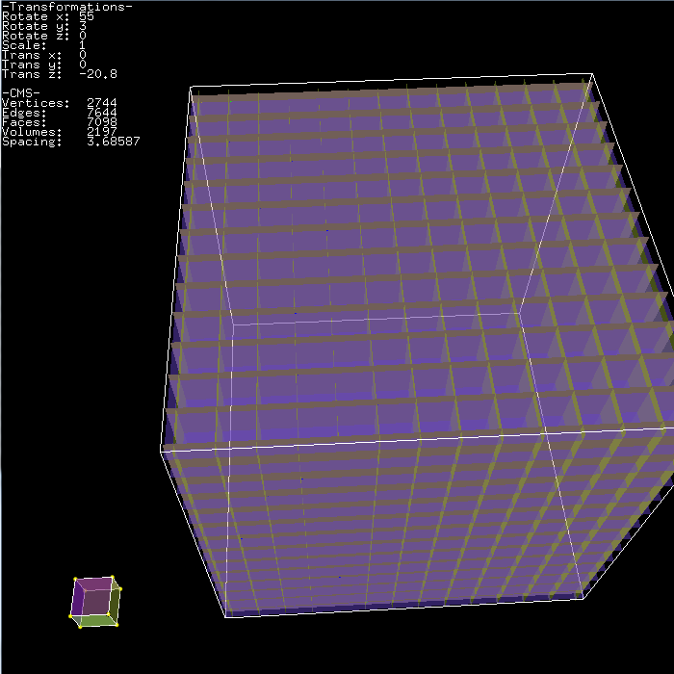
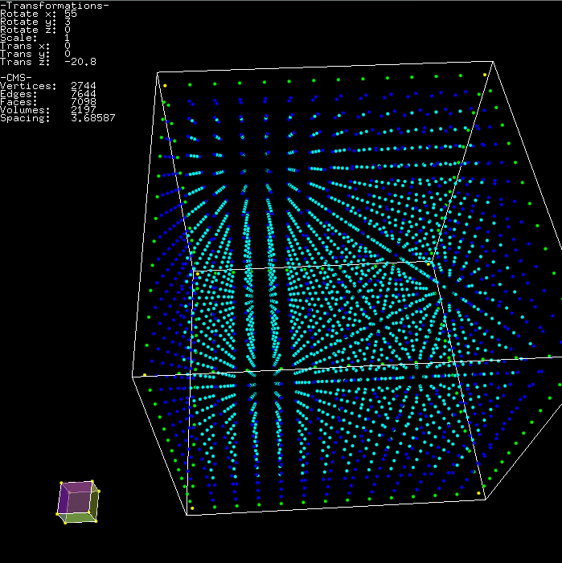
3D Grid Generation

Slide 9
Constraining the City
The width and length of the bounding box controls the total surface area of the city.

Slide 10
Results
[insert pictures of a city formed from a simple seed model, taken from varying camera positions]
[show a city with the same model but different height maps, keeping the camera angles the same]

Slide 11
Results (continued)
[insert pictures as in the previous slide, but change the seed model]

Slide 12

Demonstration

Slide 13
What We Learned
Computational geometry.
  Plane Plane Plane intersections
  Plane Polygon intersections
  Vector Math
“Simple to implement” doesn’t always mean what you think it does.

Slide 14
References
Merrell, P. and Manocha, D. 2008. Continuous model synthesis. ACM Trans. Graph. 27, 5 (Dec. 2008), 1-7. DOI= http://doi.acm.org/10.1145/1409060.1409111
Teoh, S. 2008. Algorithms for the Automatic Generation of Urban Streets and Buildings. In Proceedings of the International Conference on Computer Graphics and Virtual Reality, July 2008.
http://www.igniq.com/images/superman0706.jpg

